Slide 1
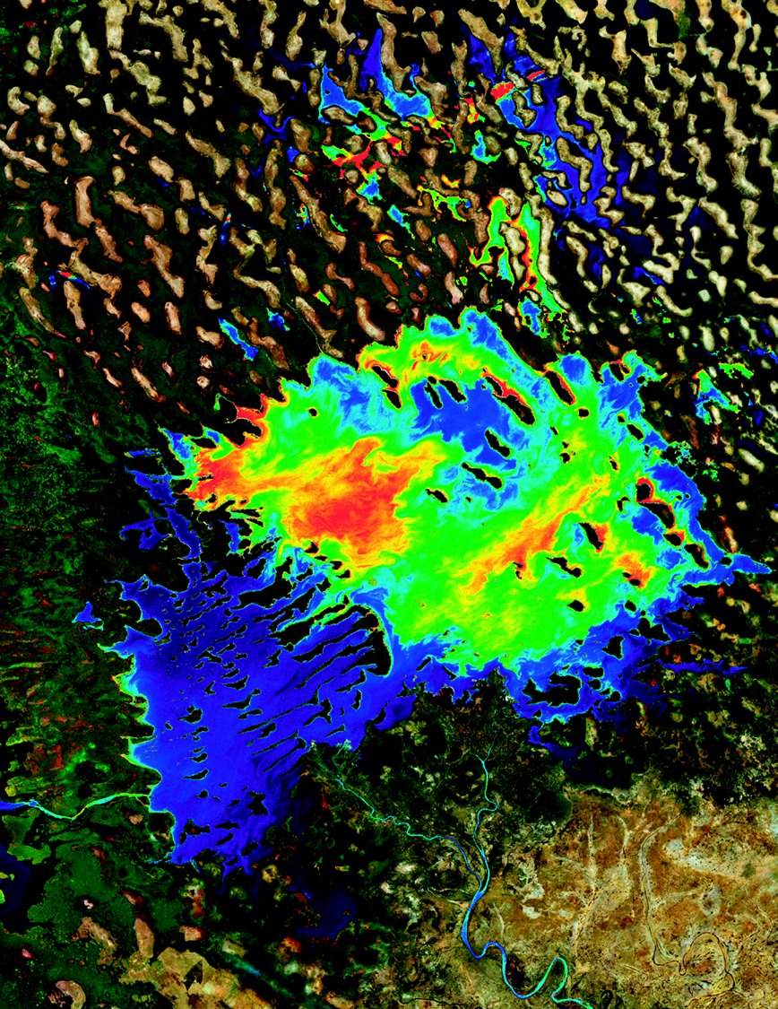
GEO AquaWatch und andere internationale Wasserqualitätsinitiativen
D-GEO Workshop
„Die Bundesanstalt für Gewässerkunde (BfG) und Wasser-Themen in GEO – Potenziale, Beiträge und Nutzung“
Philipp Saile, Leiter GEMS/Water Datenzentrum, ICWGRC, BfG
15. September 2025

Slide 2
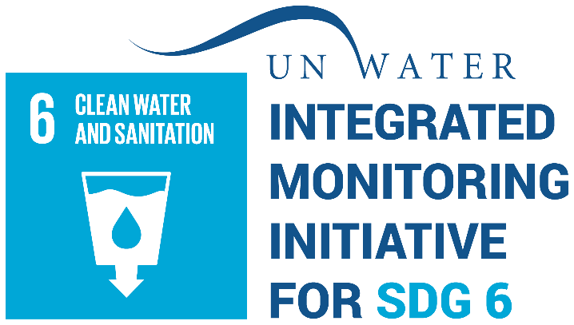

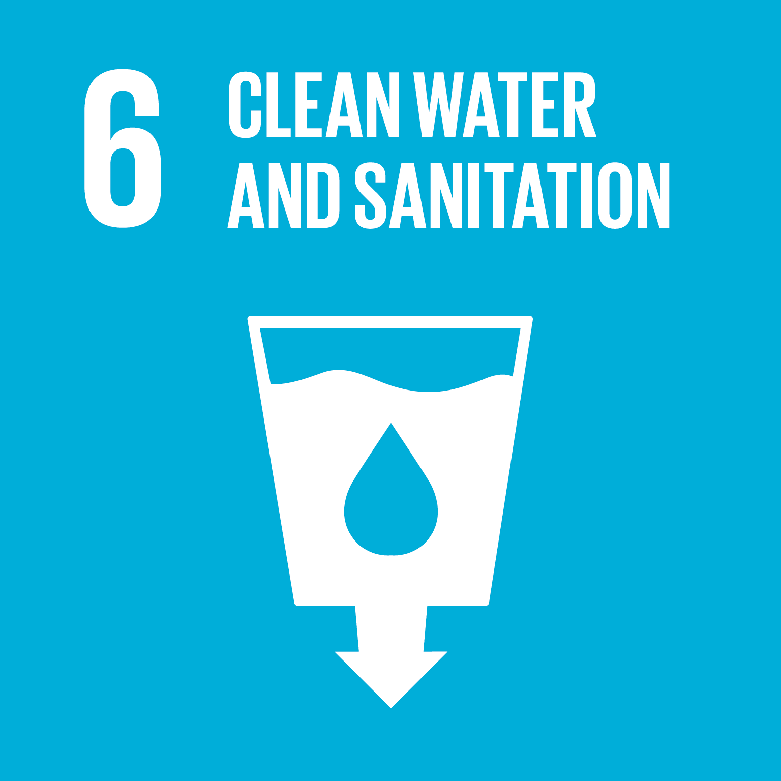
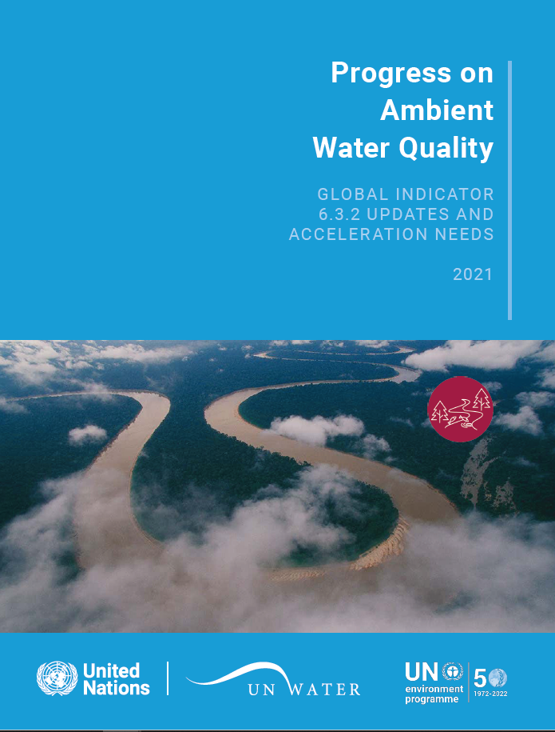
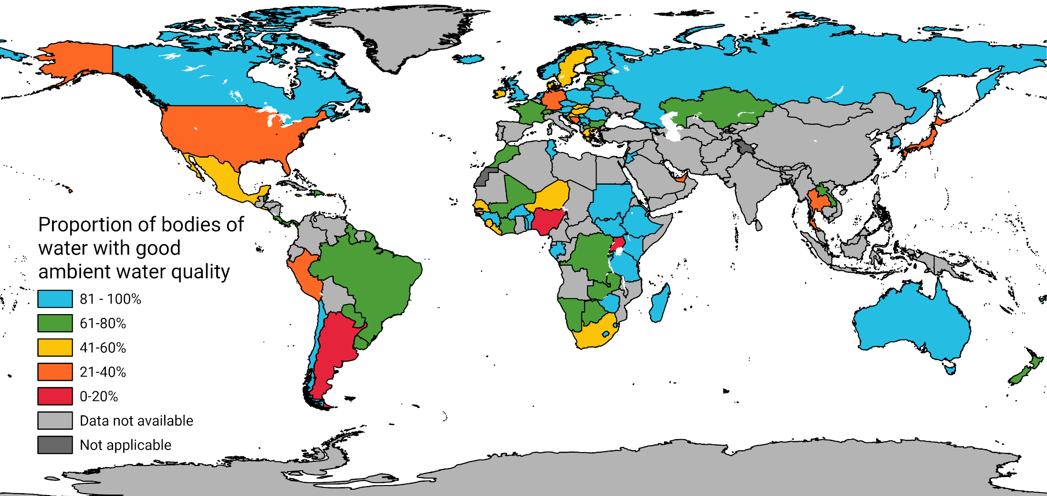
Einführung
Globale Zielsetzungen zur Verbesserung der Frischwasserqualität
Ziel 6: Verfügbarkeit und nachhaltige Bewirtschaftung von Wasser und Sanitärversorgung für alle gewährleisten.
“The Goals and targets will be followed up and reviewed using a set of global indicators. These will be complemented by indicators at the regional and national levels…”
“…global review will be primarily based on national official data sources”
2030 Agenda for Sustainable Development
SDG Indikator 6.3.2
Anteil der Gewässer mit guter Wasserqualität
SDG Unterziel 6.3
“Bis 2030 die Wasserqualität durch Verringerung der Verschmutzung, Beendigung des Einbringens und Minimierung der Freisetzung gefährlicher Chemikalien und Stoffe, Halbierung des Anteils unbehandelten Abwassers und eine beträchtliche Steigerung der Wiederaufbereitung und gefahrlosen Wiederverwendung weltweit verbessern”
https://www.sdg6data.org/maps

Slide 3





Einführung
Internationale Wasserqualitätsinitiativen im Bereich Erdbeobachtung
Fernerkundung
In-situ
International Initiative on
Water Quality

Slide 4
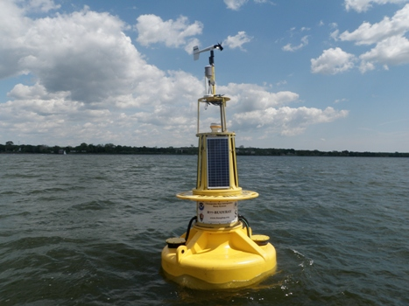
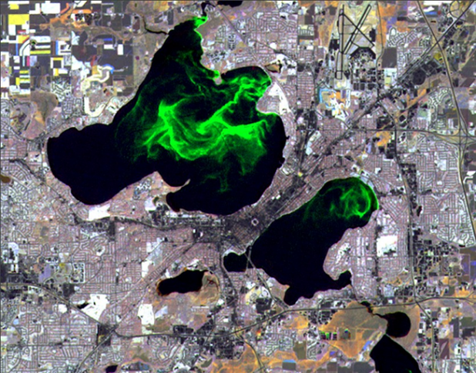



GEO AquaWatch Goal
Aims to develop the GLOBAL capacity and utility of Earth Observation-derived water quality data, products and information to support water resources management and decision making.
Lakes Mendota & Monona - University of Wisconsin Space Science and Engineering Center image
Chesapeake Bay Buoy – NOAA Image

Slide 5
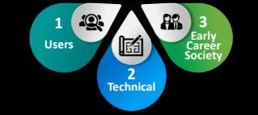
IMPACT AREAS
Global
Best Practices
COMMUNITY
Fit for Purpose
Accessible
Notes:
We seek to impact the EO water quality sector by providing Global Best Practices, emphasizing a curated product list of fit-for-the-purpose of the user audience. Many products are available and users have a hard time knowing intuitively which ones best suit their needs for frequency/resolution/information, etc. We also urge data provides to serve free and openly accessible data and information and link users to the same - while recognizing the unique service that private/commercial industry can fill for certain users with funding and specific needs.
2 working groups and the Early Career Society
3 nodes: University of Stirling - UK/European Secretariat node, IGBBerlin - CalVal, Deltares - Data Science

Slide 6
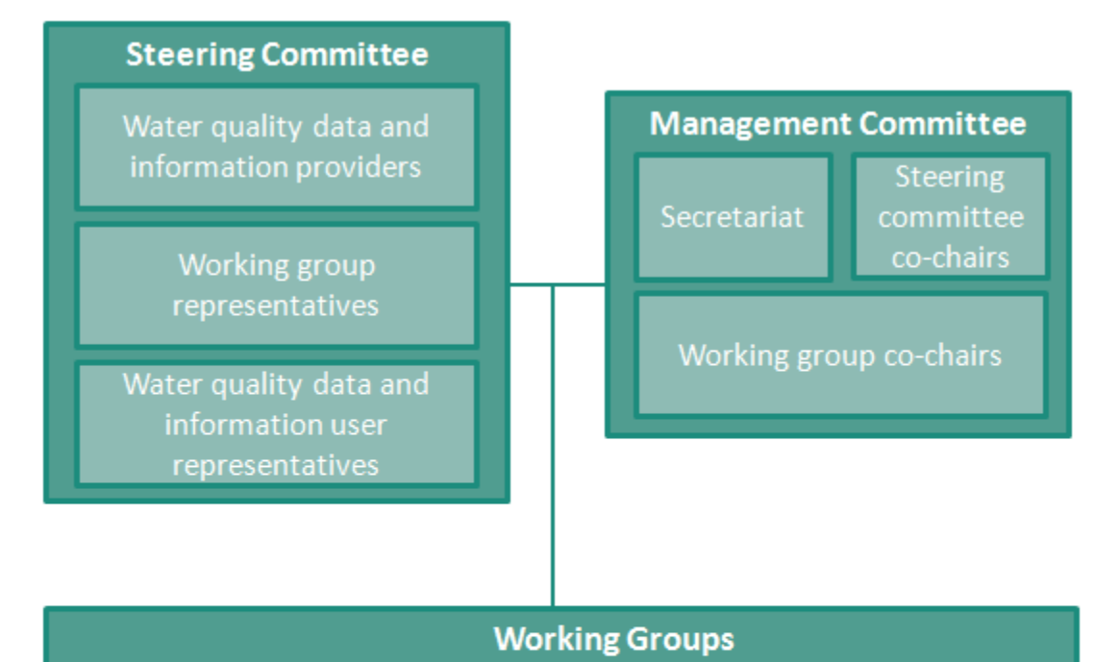
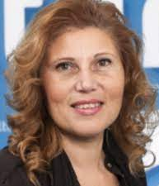

AquaWatch Governance Structure
Dr. Ghada El Serafy, Deltares
MAGIK Indigenous Network
EARLY CAREER SOCIETY
Dr. Merrie Beth Neely, GST

Slide 7
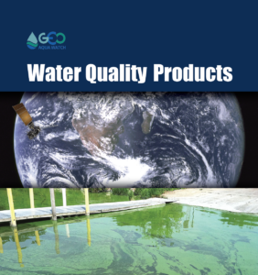
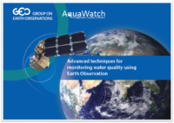
Past Success
OUTREACH & USERS
TECHNICAL BEST PRACTICES
3 Global Water Quality Inventories: monitoring projects, citizen science projects, databases
Guides: GEO AquaWatch Introductory and Advanced Algorithm and Atmospheric Correction Guidance Documents
Paper: Integrating Inland and Coastal Water Quality Data for Actionable Knowledge
Paper: Perspectives on user engagement of satellite Earth observation for water quality management
List of Available Training
Decision Tree Tools
Notes:
Successes - meeting users where they are Synthesis of EO Water Quality User Needs (4 studies), booklet and brochure meant for non-scientists, list of available training, decision tree tools for when EO might be helpful for problem solving
Make available 3 curated inventories - water quality projects, citizen science water quality projects and water quality databases
Best Practice Guidances for Introductory and Advanced users for Algorithms and atmospheric correction
Highly-cited standard setting paper on Actionable Knowledge from Water Quality data.

Slide 8
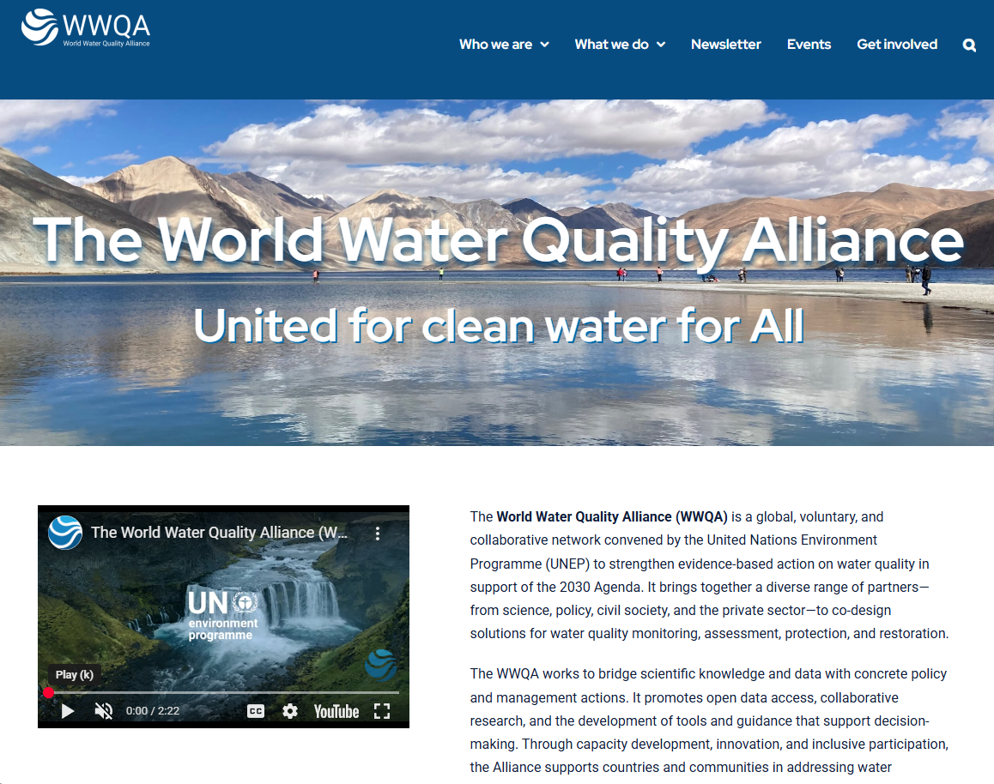

Slide 9
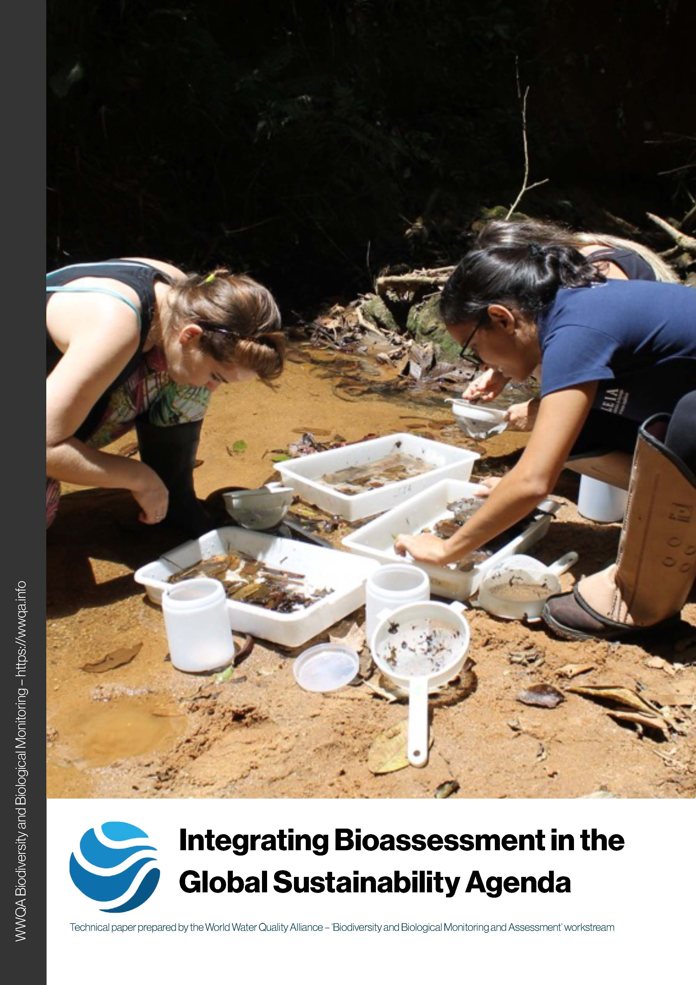
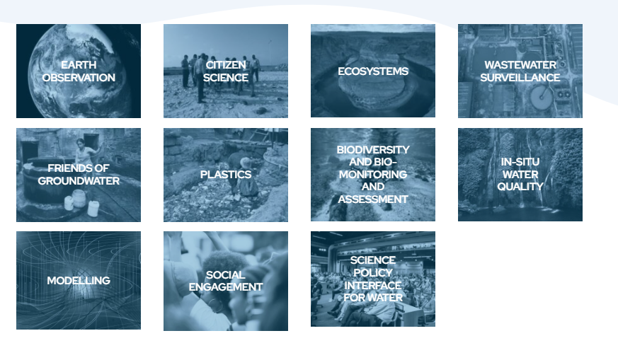
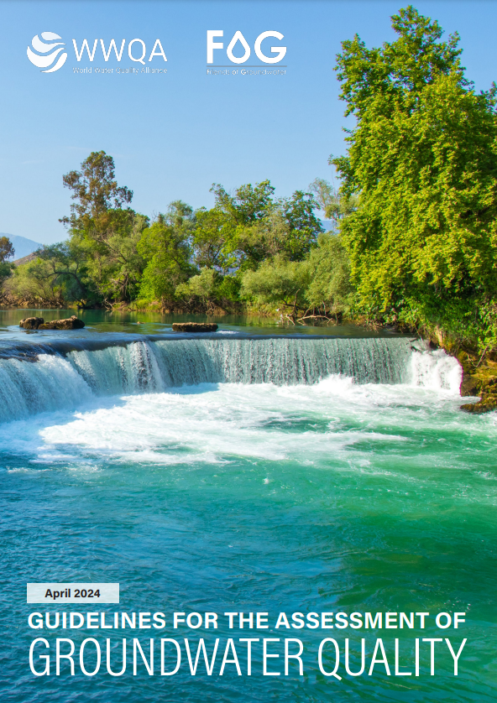
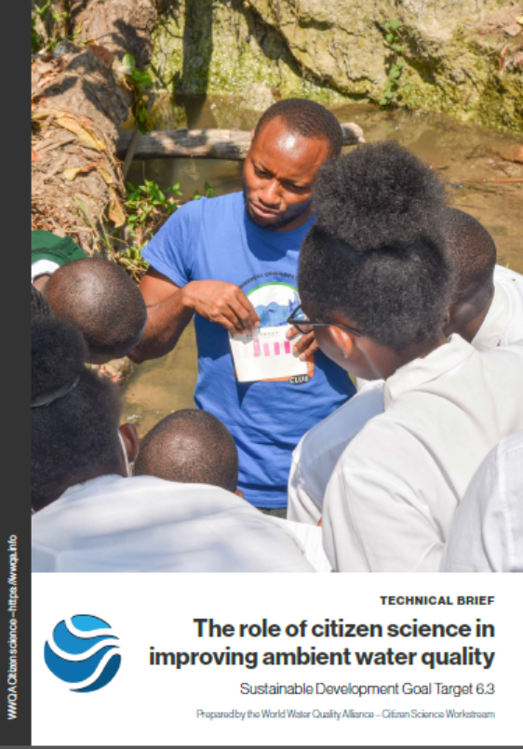
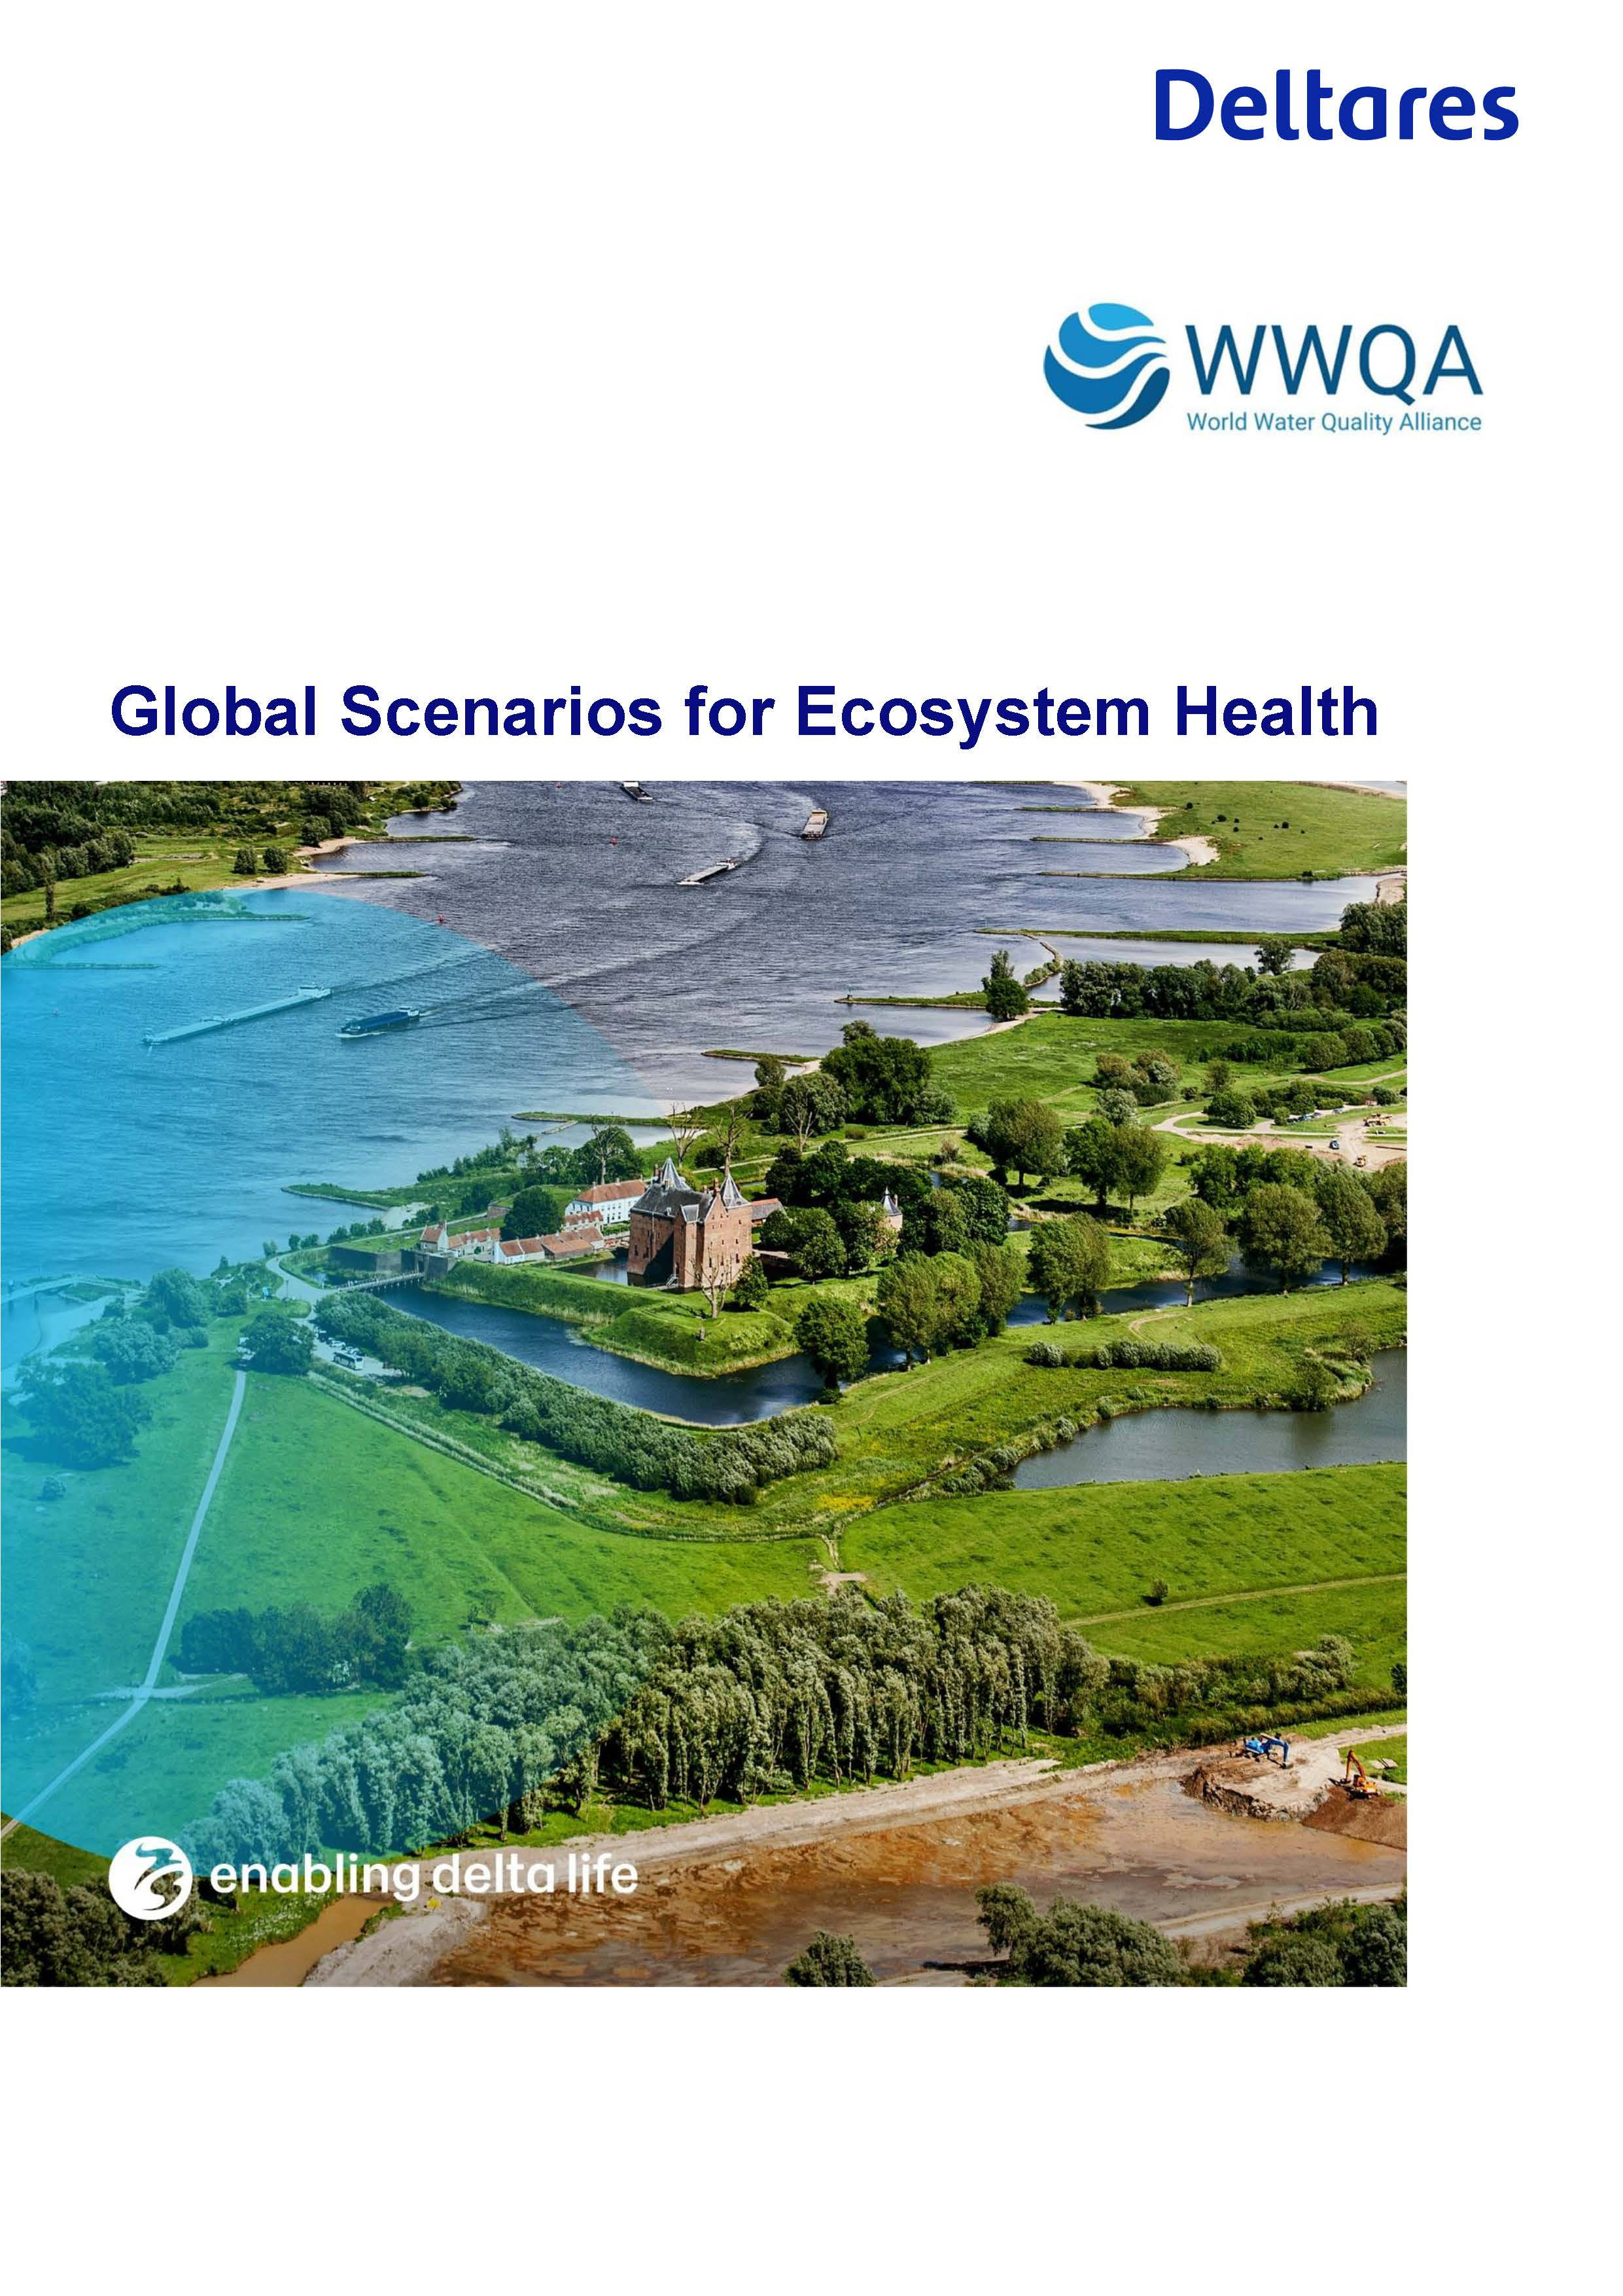
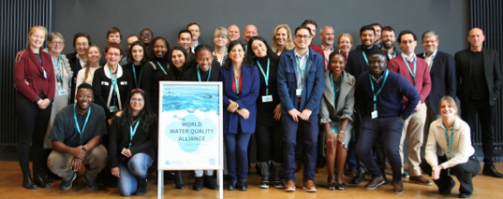
Internationale Wasserqualitätsinitiativen im Bereich Erdbeobachtung
WWQA Arbeitsgruppen

Slide 10
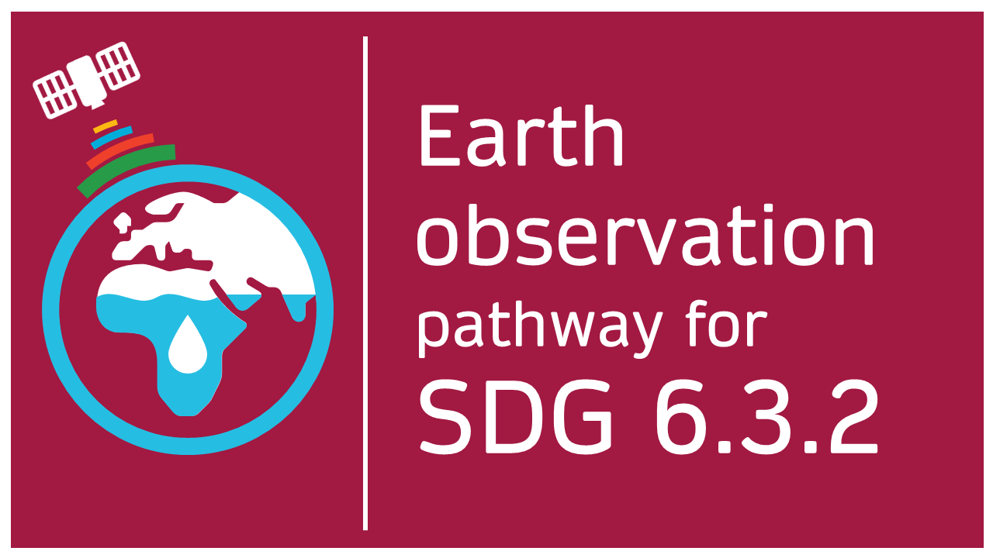
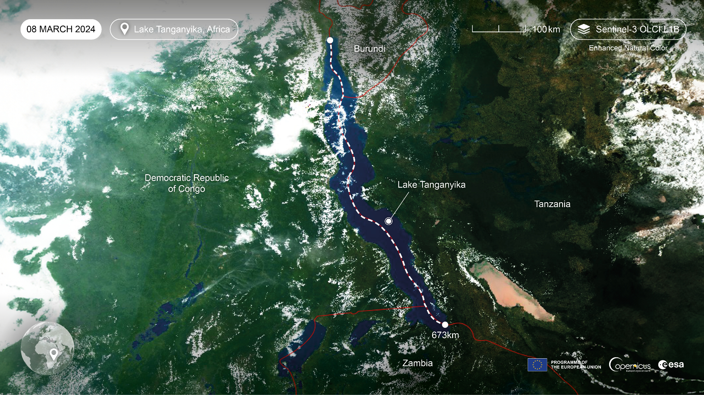
Pilot study: Lake Tanganyika
SDG 6.3.2 focal points from;
Burundi,
Congo,
Tanzania
Zambia
WWQA EO seed project 2024 | Earth observation pathway for SDG indicator 6.3.2
Notes:
As a pilot study, we selected lake Tanganyika which is very economically, socialy and environmentally important waterbody in Africa. As a transoundary waterbody, the lake also has challenges in terms of in situ collection.
Fortunately, through through the suppoet of WWQA and UNEP, we were able to connect with the SDG focal points, so the water ministries and decisionmakers, from the 4 countries around lake Tanganyika.

Slide 11
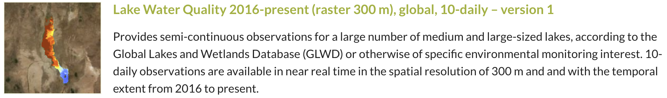
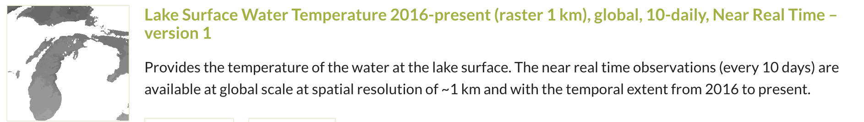
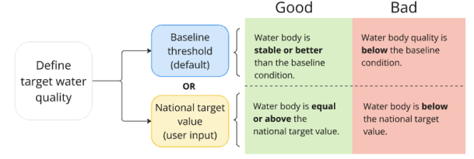
EO Indicator Requirements
    Operational product from Copernicus Land Monitoring Service (pre-release from PML)
    Globally scalable (~2000 large lakes)
    Adaptable for new variables
    Use baseline conditions to determine if water quality is stable (for that location of the lake & season) in absence of national target values
    Use of relevant variables which are detectable from EO:
    Surface water temperature
                Surface water turbidity
                Surface water chl-a
Copernicus Land Monitoring Service (CLMS) Lake Water Quality (LWQ) early release (Calimnos v2.1 L3 test dataset (July 2024) of Lake Tanganyika produced by Plymouth Marine Laboratory within the Copernicus Land Monitoring Service) and Lake Surface Water Temperature (LSWT).
WWQA EO seed project 2024 | Earth observation pathway for SDG indicator 6.3.2

Slide 12
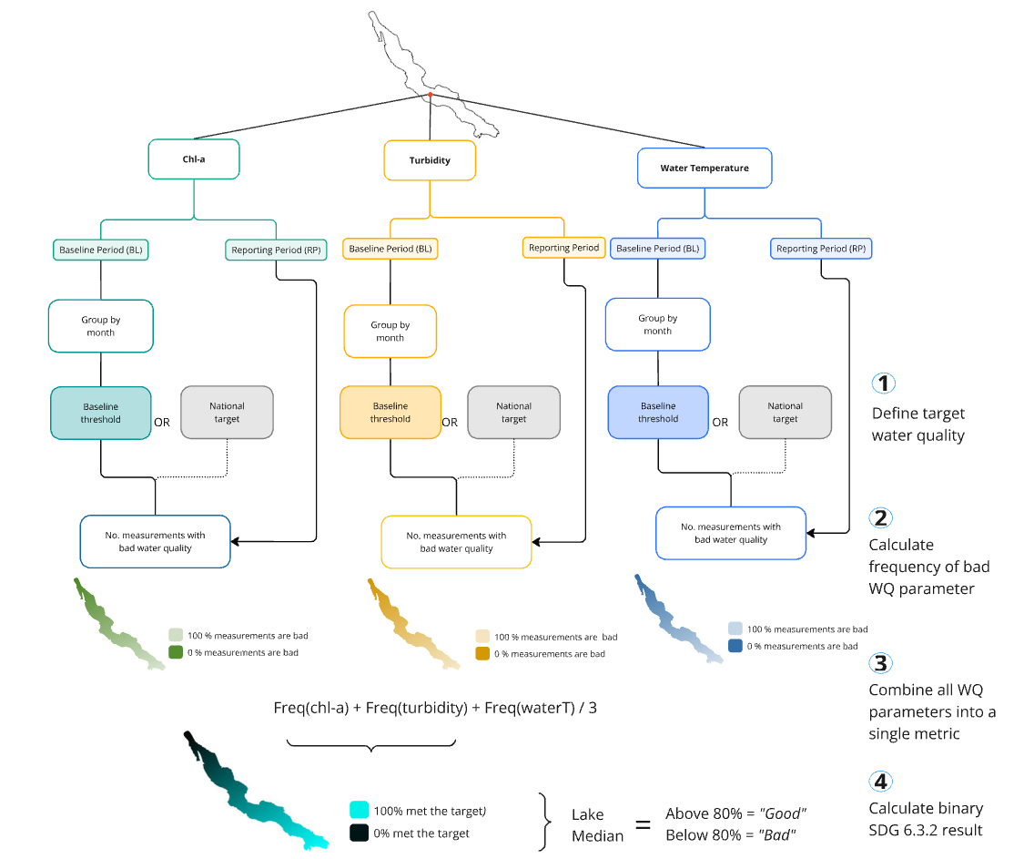
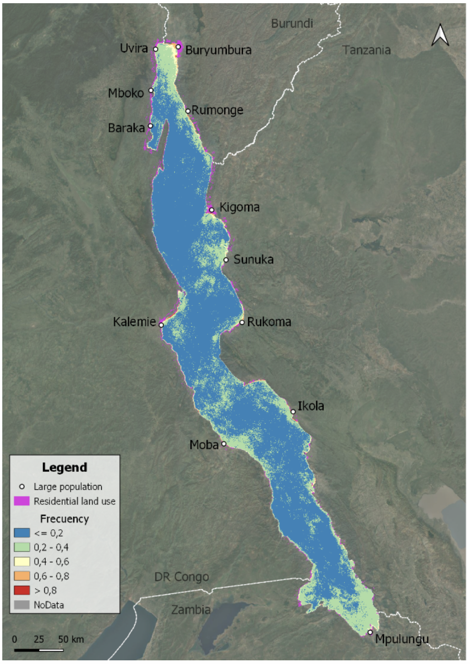
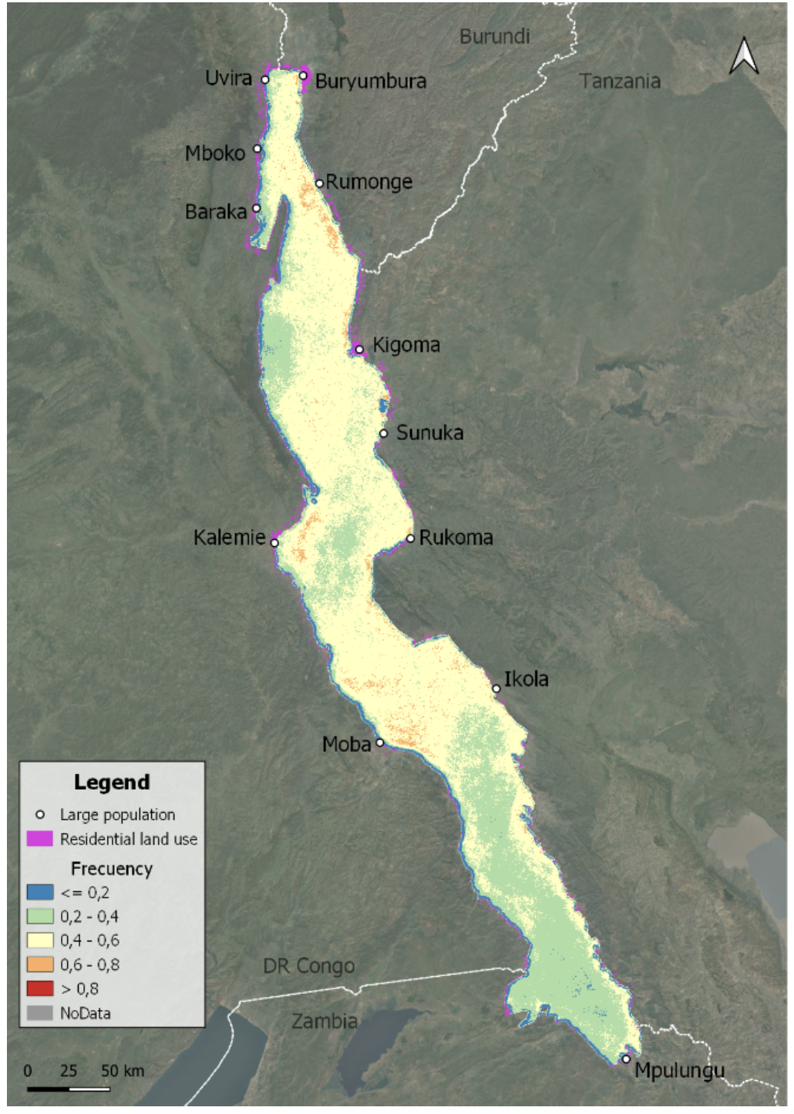
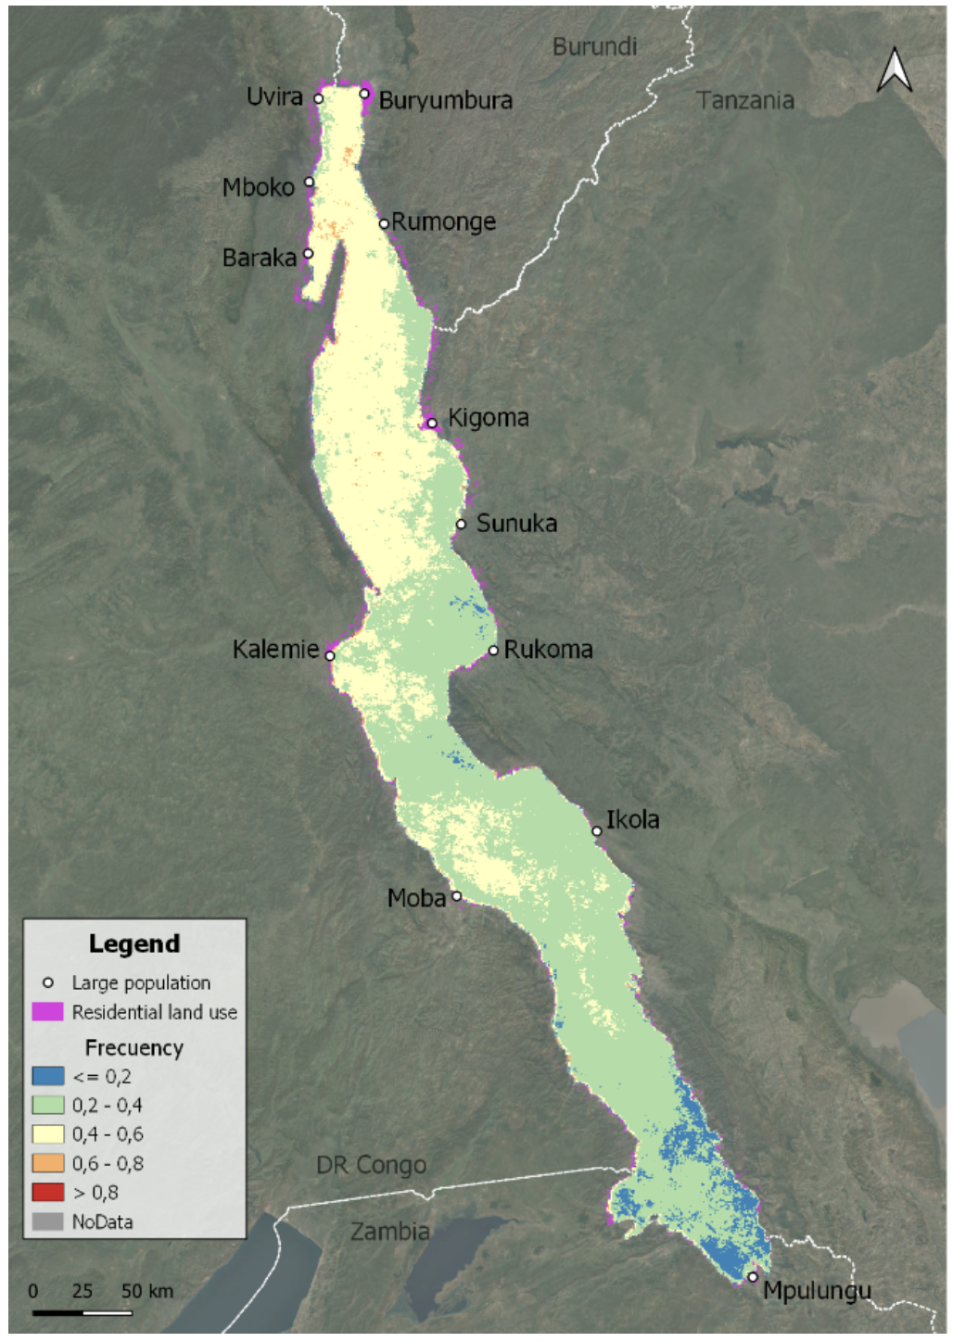
EO Indicator Method
Baseline period
Reporting period
Chlorophyll-a
Turbidity
Water temperature
WWQA EO seed project 2024 | Earth observation pathway for SDG indicator 6.3.2

Slide 13
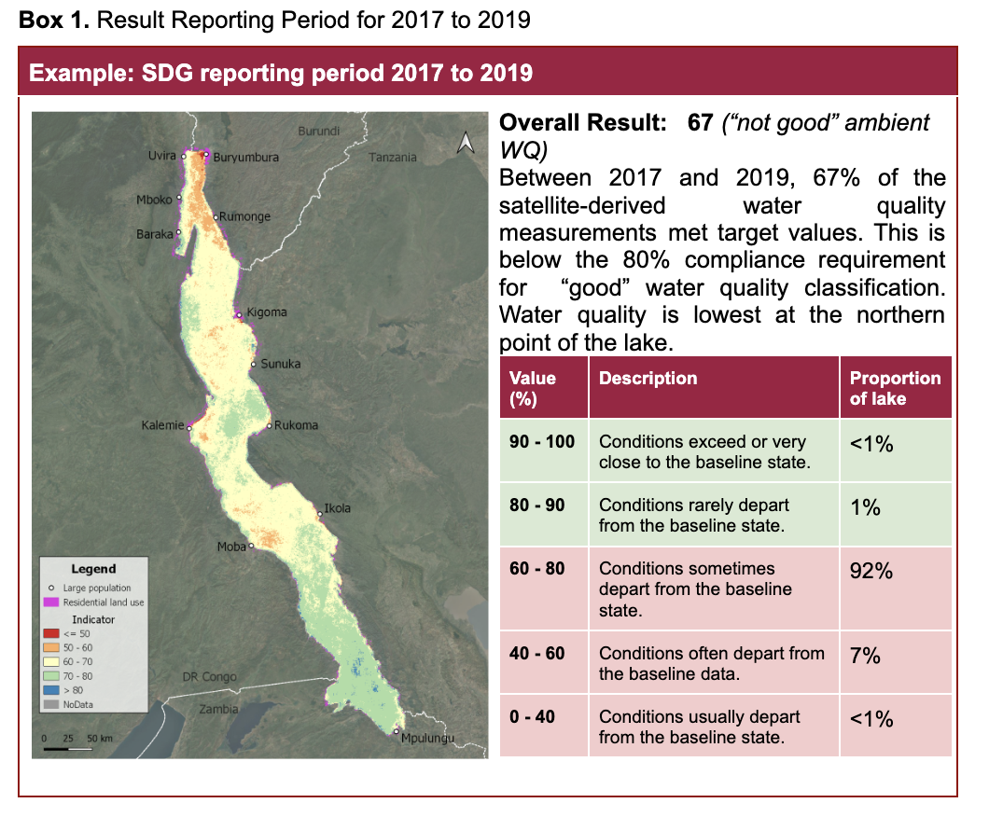
EO Indicator Results
WWQA EO seed project 2024 | Earth observation pathway for SDG indicator 6.3.2

Slide 14
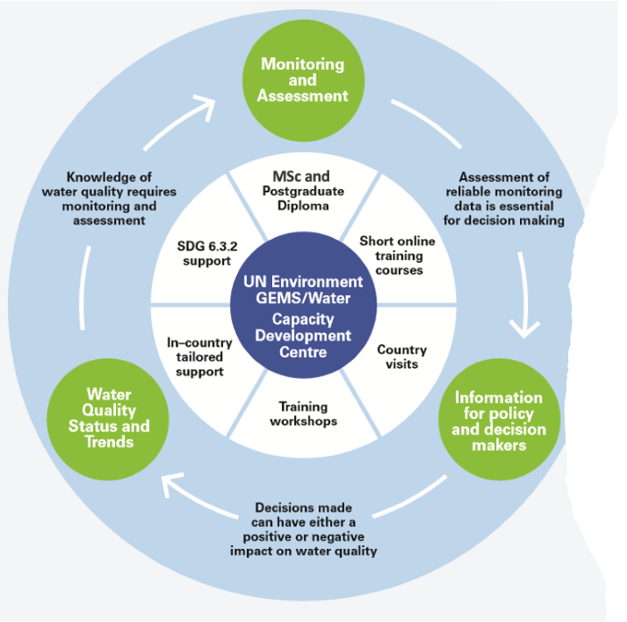
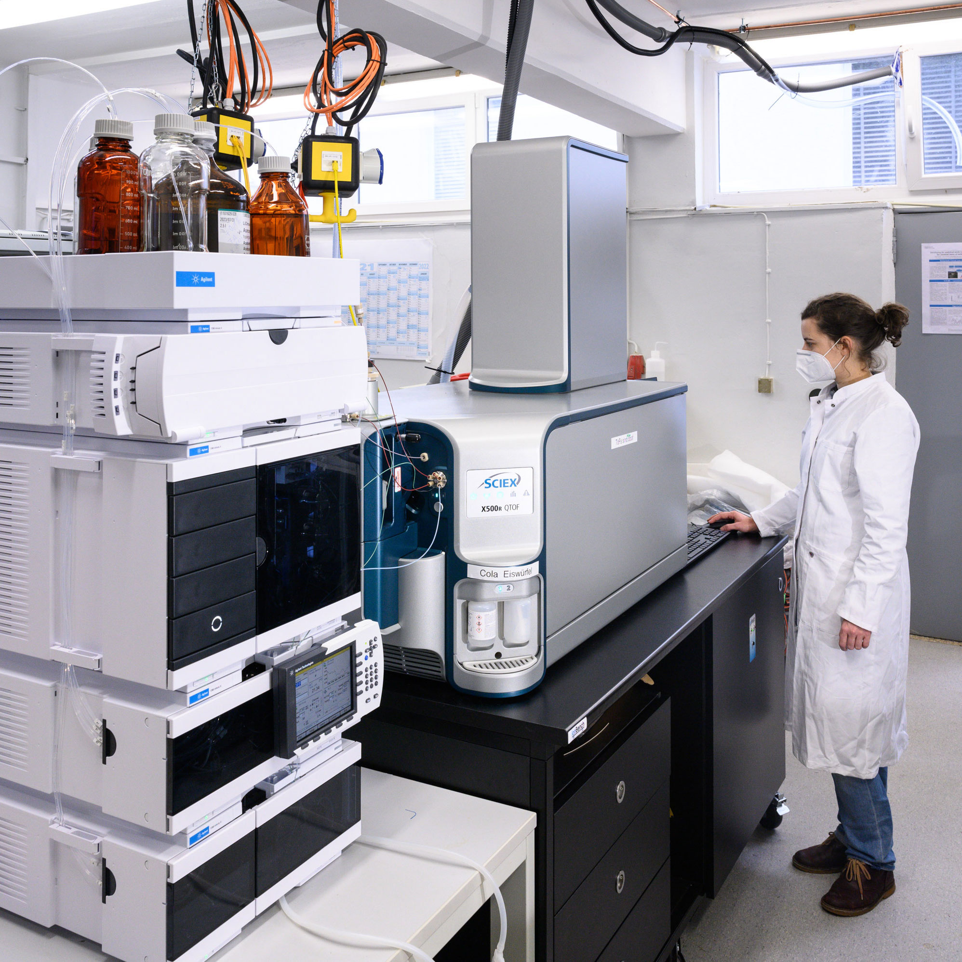

Internationale Wasserqualitätsinitiativen im Bereich Erdbeobachtung
Das Globale Umweltmessprogramm für Frischwasser (UNEP GEMS/Water)
1. Kapazitätsentwicklung
2. Messdaten & Produkte
3. Bewertungen
Nationale
Unterstützen regionale und
Workshops
E-Learning-Kurse und Studiengänge
Handbücher
Beratung & Unterstützung Datenmanagement, -analyse und Berichtswesen
Sammlung von Messdaten aus nat. Messprogrammen und Forschungsprojekten
Qualitätssicherung
Datenbereitstellung (=> FAIR)
Entwicklung von Datenprodukten
Mess-programme
globale Bewertungen
der Wasserqualität
Entwicklung von globalen Wasserqualitätsindikatoren (SDG 6)
Globales Berichtswesen zu SDG Indikator 6.3.2
Weltweite Zustandsbewertung im Rahmen der World Water Quality Alliance

Slide 15
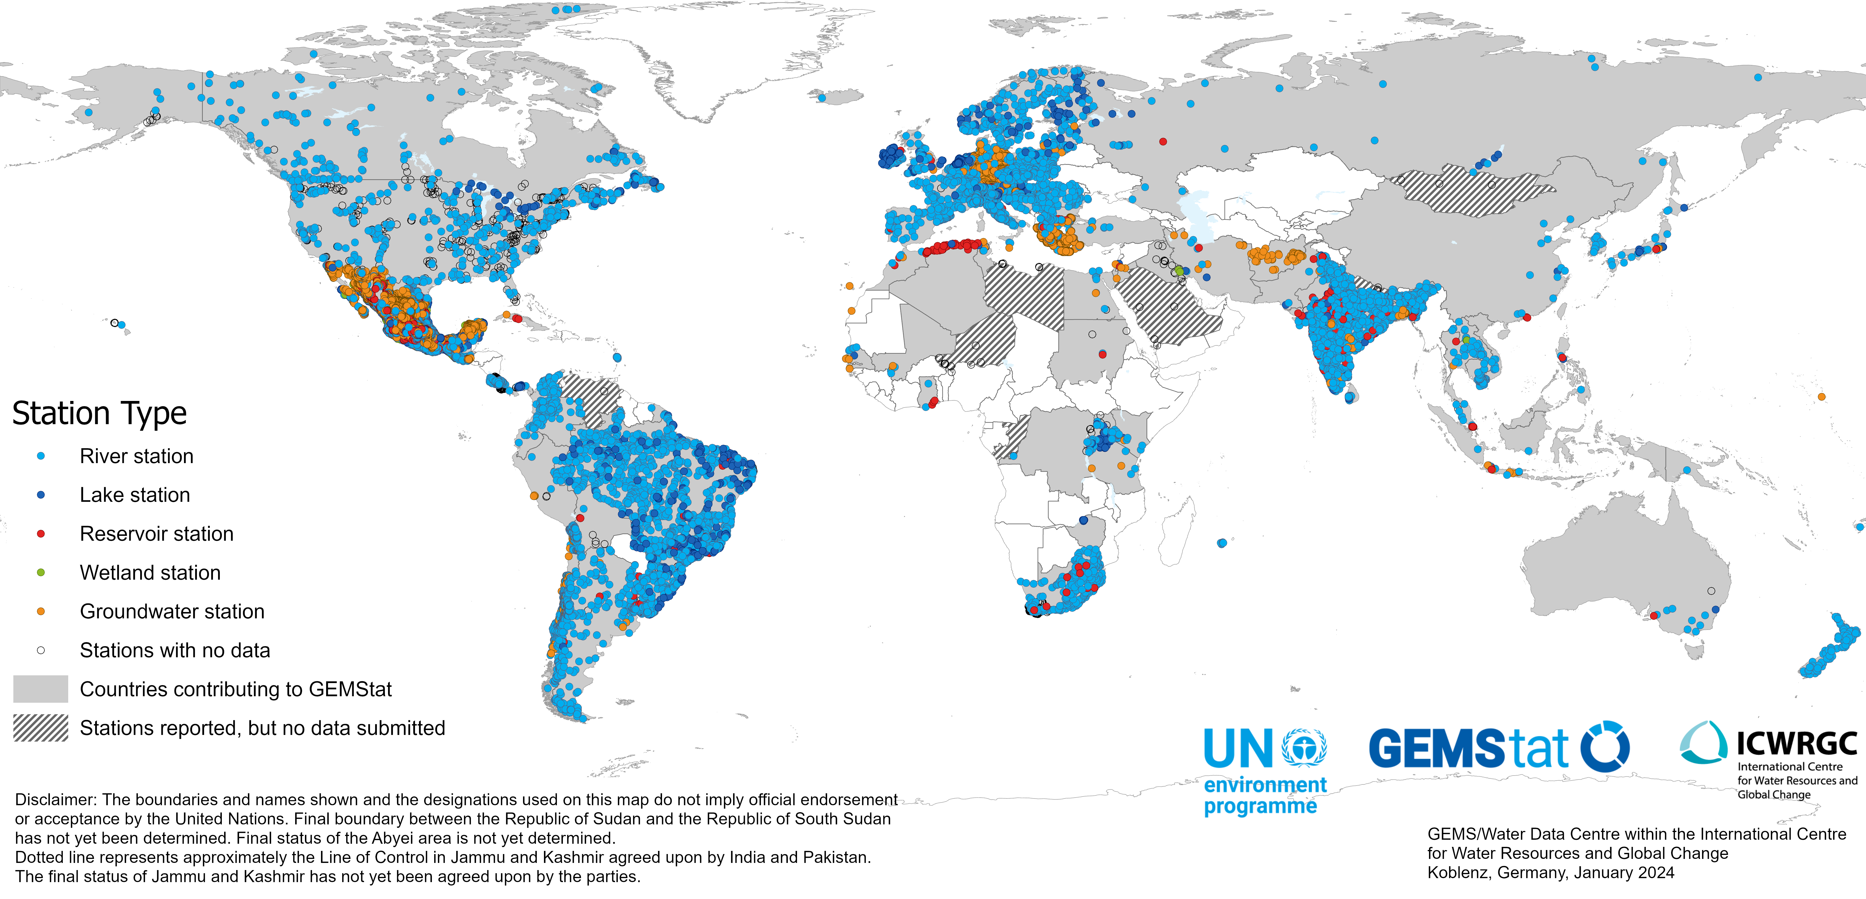
Internationale Wasserqualitätsinitiativen im Bereich Erdbeobachtung
Datenverfügbarkeit GEMStat Wasserqualitätsinformationssystem
 | 1982 | 2014 | 2025
Messstellen | 323 | 4055 | 20777
Messwerte | ~100000 | 4.6 Mio | 29.9 Mio

Slide 16
Kontakt:
Philipp Saile
saile@bafg.de

